Slide 1
Massachusetts: A Collaborative & Unique Approach to Building Open Educational Resources (OER) Policy & Practices OER Advisory Council Kickoff Meeting Quinsigamond Community College, Worcester, MA March 4, 2020
Dr. Patricia A. Marshall, Deputy Commissioner for Academic Affairs & Student Success
Massachusetts Department of Higher Education

Slide 2
The Evolution of Statewide Goals
Equity Strategic Framework
Vision Project
Initiated in 2010
7 Key outcomes
Big Three
Initiated in 2015
3 Key Outcomes
Make college more accessible and affordable for all Massachusetts residents
Equity
Initiated Dec. 2018
1 Key Outcome
Significantly raise the enrollment, attainment, and long-term success outcomes among under-represented student populations
College Participation
College Completion
Student Learning Outcomes
Workforce Alignment
Civic Learning
Closing Achievement Gaps
Research
Lead the nation in:
Close gaps in student opportunity and achievement
Improve college completion rates

Slide 3
How Does OER Advance the Commonwealth’s Equity Agenda?
Positive impact on student learning
Engagement with equity, diversity & inclusion
Increasing interest by stakeholders:
Students
Public Higher Educational Institutions
Faculty
Responding to rising costs
Increasing interest in the legislature

Slide 4
OER Working Group Recommended OER Definition
Open Educational Resources (OER) are teaching, learning and research materials in any medium – digital or otherwise – that reside in the public domain or have been released under an open license that permits no-cost access, use, adaptation and redistribution by others with no or limited restrictions (UNESCO).

Slide 5
Why is Our Approach Unique?
Partnership with Students
Grassroots Engagement with Key Stakeholders (e.g.,)
Students
Public Higher Educational Institutions
Faculty
Use of an OER Working Group to develop recommendations for BHE Consideration and Action

Slide 6
Multi-Pronged Funding Approach
PIF Funds
Federal TAACCCT Funds
Institutional Funds

Slide 7
Early DHE Action: FY 2019
Related OER Using Performance Incentive Funds:
Massasoit Community College: Early College Strategies to Enhance Learning - $59,525
Northern Essex Community College: Competency-Based Pathways in Early Education - $198,414
Direct OER Performance Incentive Fund Initiatives:
University of Massachusetts Amherst Consortium (also Worcester State, Northern Essex, and Holyoke) - $150,000
Salem State University: Viking OER & Textbook Affordability Initiative - $100,000
Total = $507,939

Slide 8
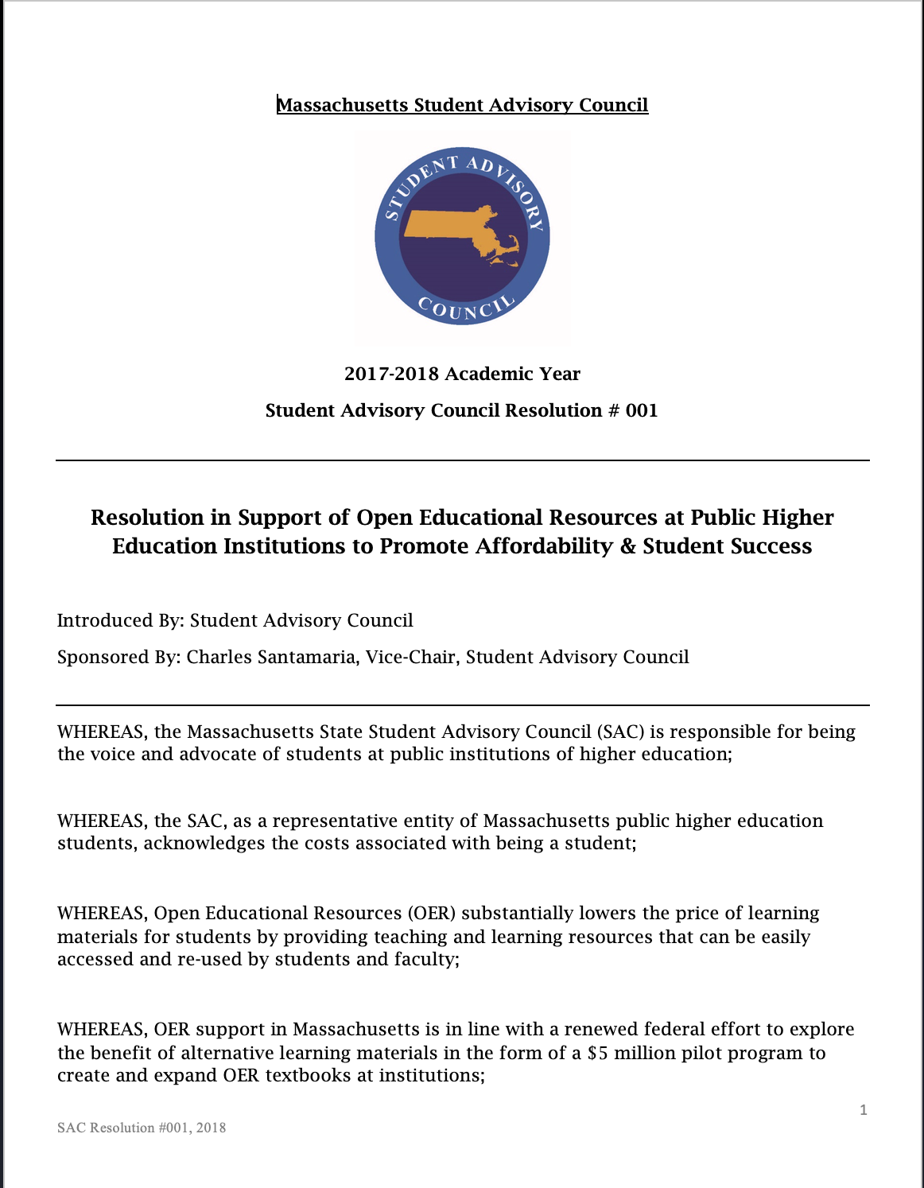
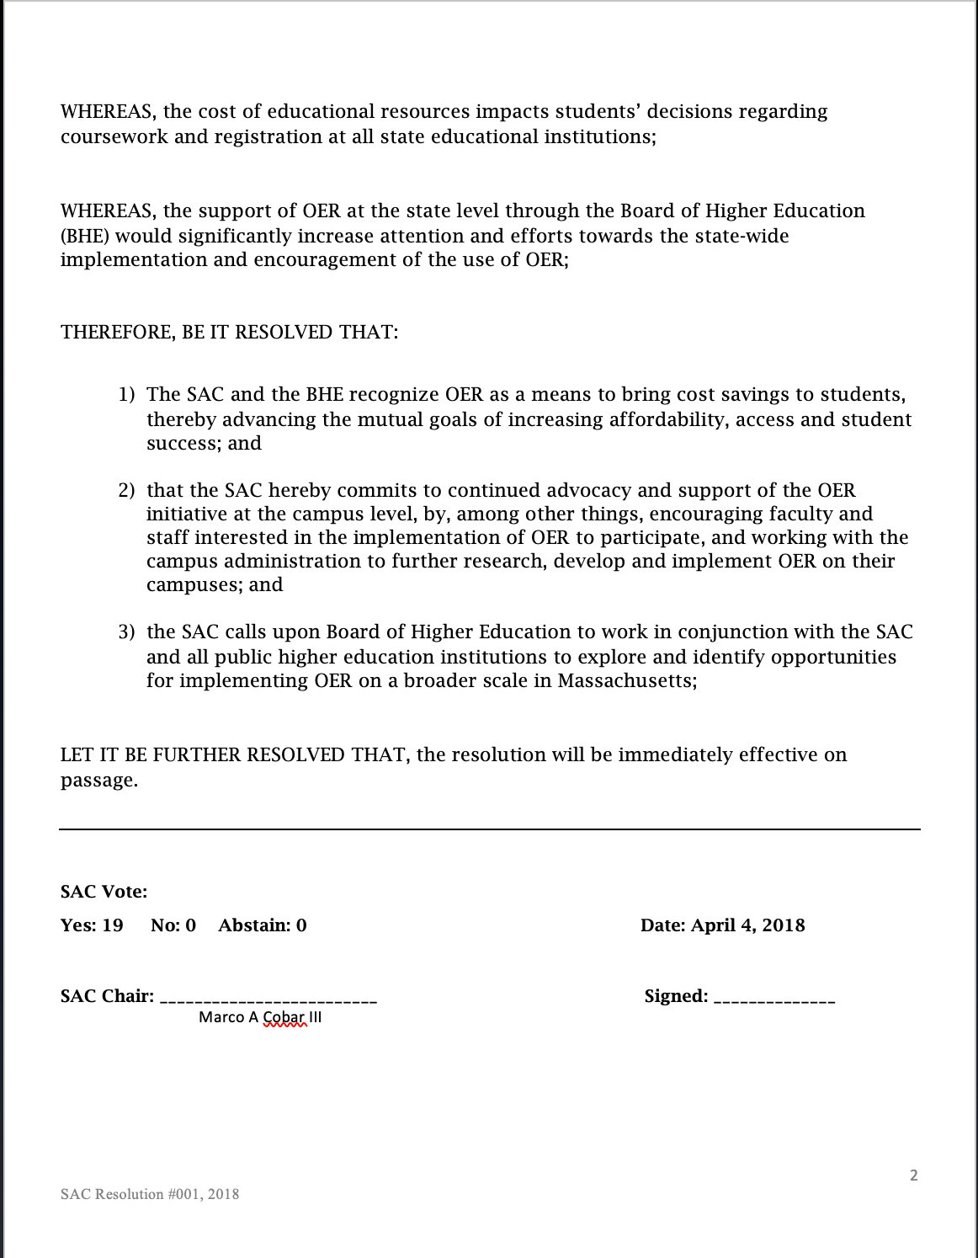
Resolution to the Board of Higher Education

Slide 9
Student Leadership: SAC Resolution
SAC hereby commits to continued advocacy and support of the OER initiative
SAC calls upon the BHE to work in conjunction with SAC and all public higher education institutions to explore and identify opportunities for implementing OER on a broader scale
The SAC and the BHE recognize OER to bring cost savings to students, thereby advancing the mutual goals of increasing affordability, access, and student success
Notes:
UPDATED

Slide 10
OER Timeline
2011
Open Education Initiative at UMass Amherst
2016
MA Go Open Project (TAACCCT)
Spring 2018
SAC Resolution in Support of OER
Creation of MA CC OER Hub: https://www.oercommons.org/hubs/masscc
AY 2018-2019
Statewide OER Consortium Project funded by PIF: Baseline Survey and Statewide Faculty Professional Development
Launched an OER Working Group
Fall 2019 – Winter 2020
OER Working Group Final Report and Recommendations
to be brought to the BHE that were approved.
Launched the OER Advisory Council

Slide 11
Massachusetts: A Collaborative & Unique Approach to Building Open Educational Resources (OER) Policy & Practices OER Advisory Council Kickoff Meeting Quinsigamond Community College, Worcester, MA March 4, 2020
Dr. Robert J. Awkward, Director of Learning Outcomes Assessment
Massachusetts Department of Higher Education

Slide 12
OER Working Group
Convened by Commissioner Santiago
Launched November 26, 2018
Staff support: Robert Awkward, Director of Learning Outcomes Assessment
Co-chairs
Marilyn Billings, Head, Office for Scholarly Research Communications, University of Massachusetts Amherst
Susan Tashjian, Coordinator of Instructional Technology, Northern Essex Community College
Membership
UMass System (4),
Faculty (4),
External (3)
State Universities (5)
Community Colleges (7)
Librarians (7),
Administrators (5),
Students (2)

Slide 13
OER Working Group Charge
Established to convene, study, evaluate, and make recommendations to address:
The growing legislative interest to identify lower cost educational resources for Massachusetts students
Achieving public higher education’s “Big Three” goals through broader utilization of OER
The issue of equity of access and participation in higher education for under-served, low-income, and first-generation students; especially students of color
Enhancing instructional effectiveness while lowering costs for students.

Slide 14
OER Working Group Process
Faculty Development Committee
Charge: Focus on how to gain faculty’s interest and willingness to teach with and/or create OER, consider barriers faculty face in adopting OER, and make recommendations about best practices that would ensure a successful effort.
Infrastructure Committee
Charge: Focus on what structures and processes need to be employed that will support and facilitate increasing the utilization of OER.
Marketing Communications Committee
Charge: Focus on what marketing strategies would need to be employed to advance and deepen the utilization of OER, what constituencies must be addressed, what are the benefits and features, what barriers could forestall success, and what tools and resources could be brought to bear to better ensure success.

Slide 15
OER Working Group Process
Policy & Legislative Committee
Charge: Focus on what issues of concern needed to be addressed by policy and/or legislative action that would enable greater utilization of OER.
Stakeholders Committee
Charge: Considered the issues and concerns of key stakeholders (e.g., bookstores, employers, students, and faculty) that needed to be addressed.

Slide 16
OER Review Process
Draft presented to AAC on April 30, 2019
Review & feedback from the OER Working Group
DHE Internal Review in May 2019
Extensive revisions from June – August 2019
Sent to public institutions on August 29, 2019 for review and comment. Due by September 20, 2019 (three weeks)
Received response from one institution (Bristol Community College)

Slide 17
Final Recommendations
Short-Term
Adopt OER definition
Establish OER statewide advisory council
Mid-Term
Provide faculty professional development
Use OER for graduate & continuing education
Long-Term
Increase funding to address campus technology challenges
Designate statewide OER coordinator
Identify OER courses in course management systems
Continue to encourage student advocacy
Expand and establish a unified statewide OER repository
Encourage the consideration of OER in faculty tenure & promotion

